Slide 1
Scientific Collaborations for Extreme Scale Science Workshop Gaithersburg, December 6-7, 2011
Richard P Mount (Workshop Co-Chair)
SLAC National Accelerator Laboratory
OSG, March 22, 2012

Slide 2
Meetings and Workshop
October – November
Organizing Committee (~20 people from Science, Facilities and CS) met 7 times by phone to develop the workshop starting point and strategy.
December 6-7, 2011
Workshop
About 50 participants from Science, Facilities and CS + Feds
Many volunteers for writing assignments
January – February, 2012
Report writing: 6 phone meetings.
All participants invited, about 20 participated vigorously

Slide 3
https://indico.bnl.gov/conferenceDisplay.py?confId=403

Slide 4
The Report

Slide 5
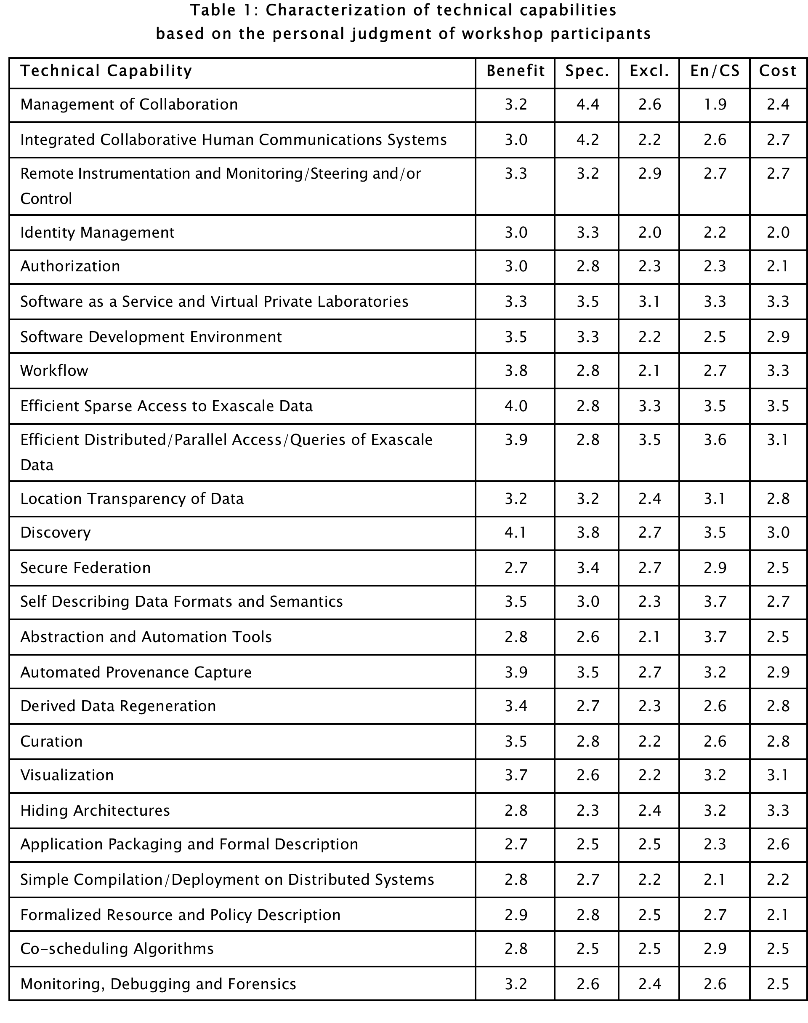
Benefit: least to most benefit to science
Spec: least to most specific to collaboration
Excl: least to most exclusive to DOE
En/CS: mainly engineering to mainly computer science
Cost: lower than 1 FTE years to more than 30 FTE years

Slide 6
Recommendations – General - Summary
Create an Institute for Extreme-Scale Collaborative Science
Fund relevant Computer Science
Fund relevant development, consolidation, and support of software and services

Slide 7
Recommendations – Technologies for Teams
Develop Office of Science guidelines for centrally supported services, with special focus on the Software-as-a-Service mode of delivery. The central support and any essential research and development may be provided by ASCR in concert with science programs or by commercial services where appropriate
Conduct research into new methods for delivering innovative services to meet unique needs of collaborative extreme-scale science, that meet needs for consistency, economies of scale, and sustainability

Slide 8
Recommendations – Technologies for Data
Solicit proposals in the area of Integrated Data Operations for research into groundbreaking new tools, and for the consolidation and generalization of promising existing approaches
Solicit proposals focused on moving existing provenance technologies into extreme-scale science, thus exposing the extent to which both fundamental research and generalization/support are required. Research and development to fill clearly identified gaps should also be encouraged

Slide 9
Recommendations – Technologies for Processing
The first vital step in rendering differences invisible is to formalize how resource characteristics and policies are to be captured and made available to the automated workflow management systems that will achieve the goal of transparency. Research and development into this formalization and its implementation should be given priority
The software components for proposed research projects should include, as part of the design, a plan for how monitoring information will be produced and consumed. Ideally, the solicitation would avoid unnecessary diversity by providing guidance as to preferred existing (and widely-used) formats and methodologies. The program should also solicit research on scalable data reduction and analysis methods for the growing volume of end-to-end monitoring information

Slide 10
Recommendations – Less Technical Issues
Establish coordination across the Office of Science to ensure that the benefits to extreme-scale science of funding research into new approaches are correctly balanced against the benefits of supporting existing widely used tools or generalizing apparently domain-specific tools.
Research opportunities should support joint activities that will allow emerging data-intensive collaborative science to engage with more established data-intensive collaborative science disciplines. This will promote an understanding of where generalizations of existing successful approaches might be the best way forward for a range of collaborative sciences

Slide 11
Latest News
From: Richard Mount <richard.mount@slac.stanford.edu>
Date: Thu, 22 Mar 2012 10:00:15 -0700
To: "'scess-report@nersc.gov'" <scess-report@nersc.gov>
Cc: "Carlson, Richard" <Richard.Carlson@science.doe.gov>, "Ndousse-Fetter, Thomas" <Thomas.Ndousse-Fetter@science.doe.gov>
Subject: Funding Opportunity Resulting from the SCESS Report
Scientific Collaborations at Extreme-Scale
Funding Opportunity Number: DE-FOA-0000695
University: https://www.fedconnect.net/fedconnect/?doc=de-foa-0000216&agency=..
Lab: http://www.science.doe.gov/grants/pdf/LAB_12-695.pdf
Dear SCESS Community,
Additional Information based on phone and email conversations with Rich
Carlson (Please circulate widely).

Slide 12
Latest News (2)
1) The priorities for this funding opportunity are those in the SCESS
report (Don't try to over analyze the wording in the call - the report
takes precedence).
2) The SCESS report is at
http://science.energy.gov/ascr/news-and-resources/program-documents/
3) It is hoped that this program can be expanded in the future. This hope
is most likely to be realized if the current call results in strong,
forward-looking proposals.
4) Rich has already had discussions with HEP (Lali Chaterjee), BER (Renu
Joseph) and FES (John Mandrakes) about co-funding larger projects. Such
co-funding would be additional to the $4.7M of ASCR funds.
PI's should contact Rich first to talk about this co-funding opportunity.
They should identify which science program they want to collaborate with
and who those researchers are. Rich will then inform the proper program
manager to see if there is interest in this particular proposal. The PI
should then talk with that program manager as well about budgets and
specific work items. ASCR will get reviewers from the other program
offices to complete this process.

